Slide 1
Data Science Engineering Methods and Tools Lecture 4
Northeastern University
College of Engineering
Multidisciplinary Graduate Engineering Department
INFO 6105 – Fall 2024
Instructor: Abdolreza Mosaddegh

Slide 2
Regression Analysis
Regression analysis is used to:
Predict the value of a response variable based on the value of at least one explanatory variable
Explain the impact of changes in an explanatory variable on the response variable
Regression falls under supervised learning wherein the algorithm is trained with both input features and output variable.
Murder-rate= 2.56 poverty −29.91

Slide 3
Regression Analysis
Regression analysis is a statistical method used to model the relationship between a dependent variable (outcome) and one or more independent variables (features)
The dependent variable is typically an outcome, and the independent variables may contribute to predicting that outcome.
Used to determine how well the set of variables predict the dependent variable and which variables are significant predictors.
Salary = a*Working-Hours + b*Work-Experience + c*Education-Level + … + 2000
Dependent
Variable
Independent
Variables

Slide 4
Linear Regression
Fitting the data: finding the equation for the straight line (linear) that does the best job of modeling dependent variable as determined by independent variables.
Average-Income = b * College-Degree-Rate + a

Slide 5
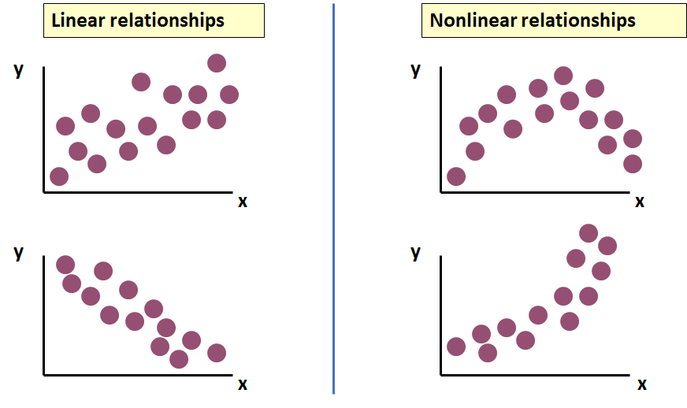
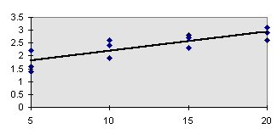
Linear Relationship
In Linear Regression, relationship between x and y is described by a straight line (y = bx + a).
Only linear relationships can be modeled using Linear Regression Model
Needs a measure of the linear relationship
Linear Regression

Slide 6
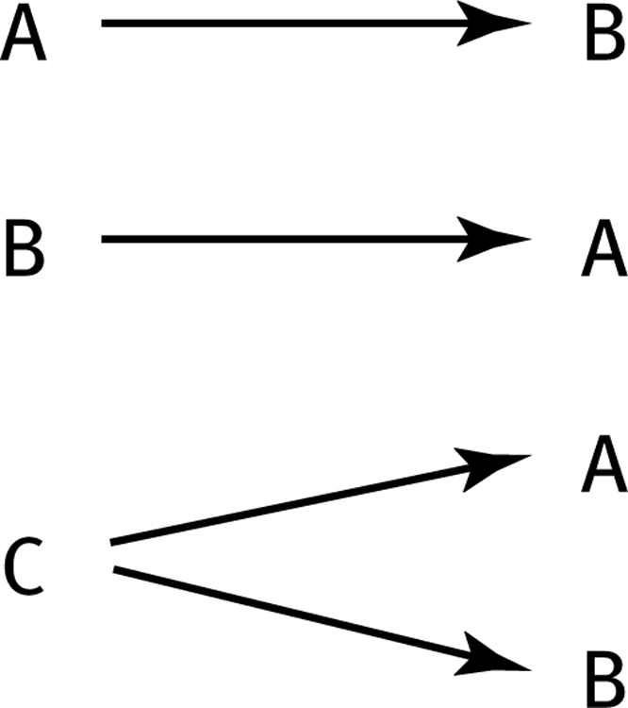
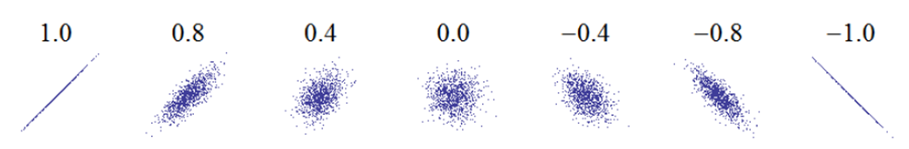
Quantifying Linear Associations
Correlation is used to measure strength of the association between two variables
Correlation may indicate any type of association, but in statistics it usually refers to the degree to which a pair of variables are linearly related
Only concerned with strength and direction of the relationship
No causal effect is implied
Magnitude and direction of correlations
Invisible third variables

Slide 7
Magnitude and Direction of Correlation
Strong direct relationships
Weak direct relationships
y
y
x
x
Strong indirect relationships
Weak indirect relationships
y
y
x
x

Slide 8
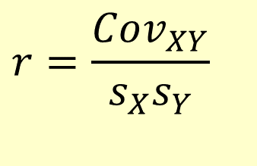
Correlation Coefficient
The correlation coefficient (r) is used to measure the strength of the linear relationship in the sample observations
The value of correlation coefficient depends on standard deviation and covariance of two variables
y
y
x
x
$$r=\frac{Cov_{XY}}{s_{X}s_{Y}}$$

Slide 9
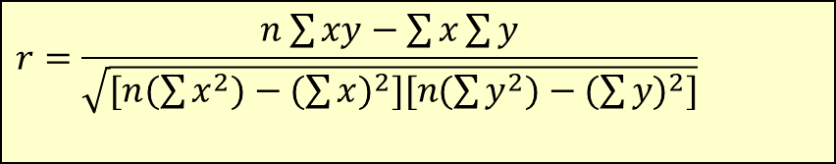
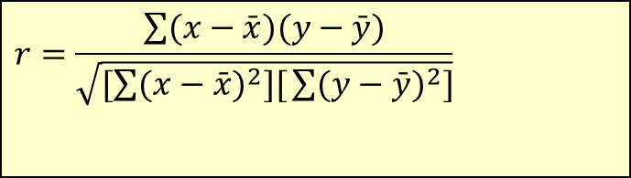
Calculating the Correlation Coefficient
Correlation coefficient (Pearson):
$$r=\frac{\sum{(x−\bar{x})(y−\bar{y})}}{\sqrt{[\sum{(x−\bar{x})^{2}][}\sum{(y−\bar{y})^{2}]}}}$$
or the algebraic equivalent:
$$r=\frac{n\sum{xy−\sum{x\sum{y}}}}{\sqrt{[n(\sum{x^{2})−(\sum{x)^{2}][n(\sum{y^{2})−(\sum{y)^{2}]}}}}}}$$
where:
r = Sample correlation coefficient
n = Sample size
x = Value of the explanatory variable
y = Value of the response variable

Slide 10

Calculation Example
Tree Height | Trunk Diameter
y | x | xy | y² | x²
35 | 8 | 280 | 1225 | 64
49 | 9 | 441 | 2401 | 81
27 | 7 | 189 | 729 | 49
33 | 6 | 198 | 1089 | 36
60 | 13 | 780 | 3600 | 169
21 | 7 | 147 | 441 | 49
45 | 11 | 495 | 2025 | 121
51 | 12 | 612 | 2601 | 144
Σ=321 | Σ=73 | Σ=3142 | Σ=14111 | Σ=713
Is there a strong correlation between height of a tree and diameter of trunk?
$$r=\frac{n\sum{\text{xy}−\sum{x\sum{y}}}}{\sqrt{[n(\sum{x^{2})−(\sum{x)^{2}][n(\sum{y^{2})−(\sum{y)^{2}]}}}}}}$$

Slide 11
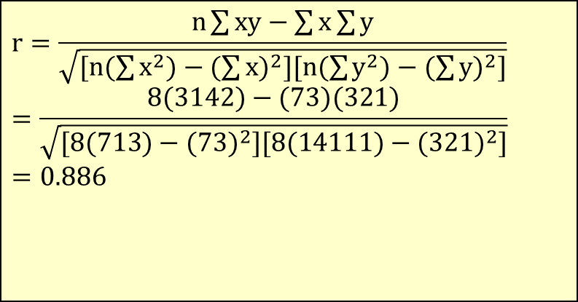
Calculation Example
Tree Height,
y
$$r=\frac{n\sum{\text{xy}−\sum{x\sum{y}}}}{\sqrt{[n(\sum{x^{2})−(\sum{x)^{2}][n(\sum{y^{2})−(\sum{y)^{2}]}}}}}} \\ =\frac{8(\text{3142})−(\text{73})(\text{321})}{\sqrt{[8(\text{713})−(\text{73})^{2}][8(\text{14111})−(\text{321})^{2}]}} \\ =\text{0.886}$$
Trunk Diameter, x
r = 0.886 → relatively strong positive
linear association between x and y

Slide 12
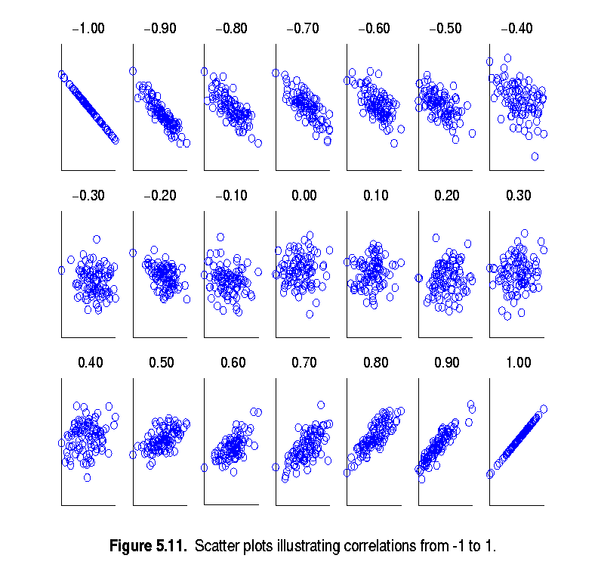
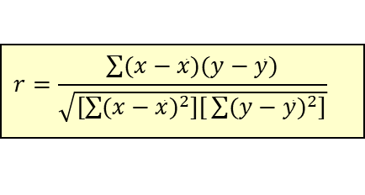
Interpretation of Correlation Coefficient
It shows the magnitude and direction of the relationship.
r ranges between -1 and 1
The closer to 1, the stronger the positive linear relationship
The closer to -1, the stronger the negative linear relationship
The closer to 0, the weaker linear relationship
$$r=\frac{\sum{(x−\bar{x})(y−\bar{y})}}{\sqrt{[\sum{(x−\bar{x})^{2}][}\sum{(y−\bar{y})^{2}]}}}$$

Slide 13
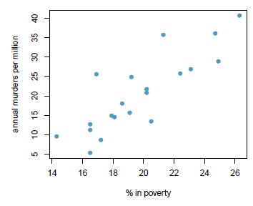
Coefficient of Determination (R Squared)
Represents the proportion of the variance in the dependent variable that is explained by the independent variables in the model and gives a measure of the model’s predictive power.
Coefficient of Determination is the square of Coefficient of Correlation (r) in simple linear regression.
Values range from 0 to 1. 0 means the model explains none of the variance. 1 means the model explains all of the variance.
Big value of R-Squared indicates the dependent variable can be modeled using independent variable by linear regression
e.g., if R-Squared is 0.71 it means that 71% of the variability in the murder rates is explained by the model, i.e. percentage living in poverty.

Slide 14
Simple Linear Regression - Terminology
“Regress X on Y” will mean to finding the equation for the straight-line fits best to training data on modeling Y based on X
Simple refers to the fact that there is a single independent variable in a linear relationship with the dependent variable
ŷ is the respective estimate of the y-value. This means that for each x-value the corresponding y-value is estimated.

Slide 15
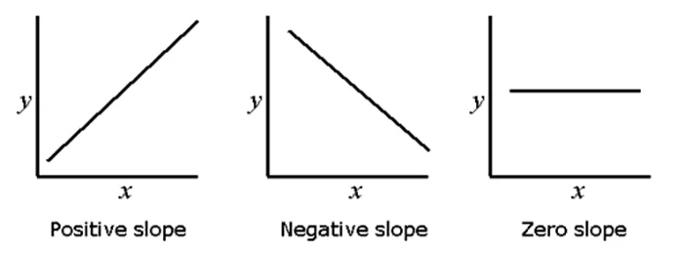
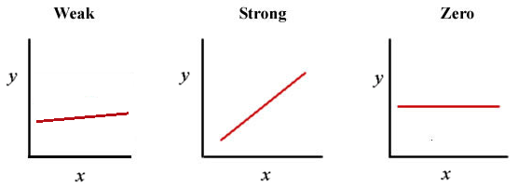
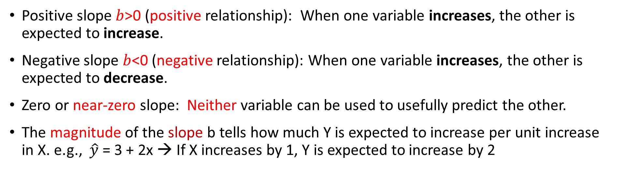
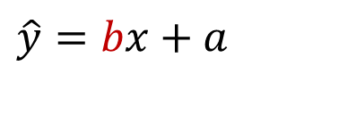
Interpreting the Slope (Reg Coefficient)
$$\hat{y}=bx+a$$
Positive slope $b$>0 (positive relationship): When one variable increases, the other is expected to increase.
Negative slope $b$<0 (negative relationship): When one variable increases, the other is expected to decrease.
Zero or near-zero slope: Neither variable can be used to usefully predict the other.
The magnitude of the slope b tells how much Y is expected to increase per unit increase in X. e.g., $\hat{y}$ = 3 + 2x → If X increases by 1, Y is expected to increase by 2

Slide 16
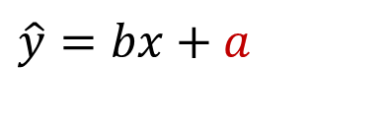
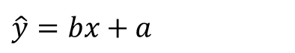
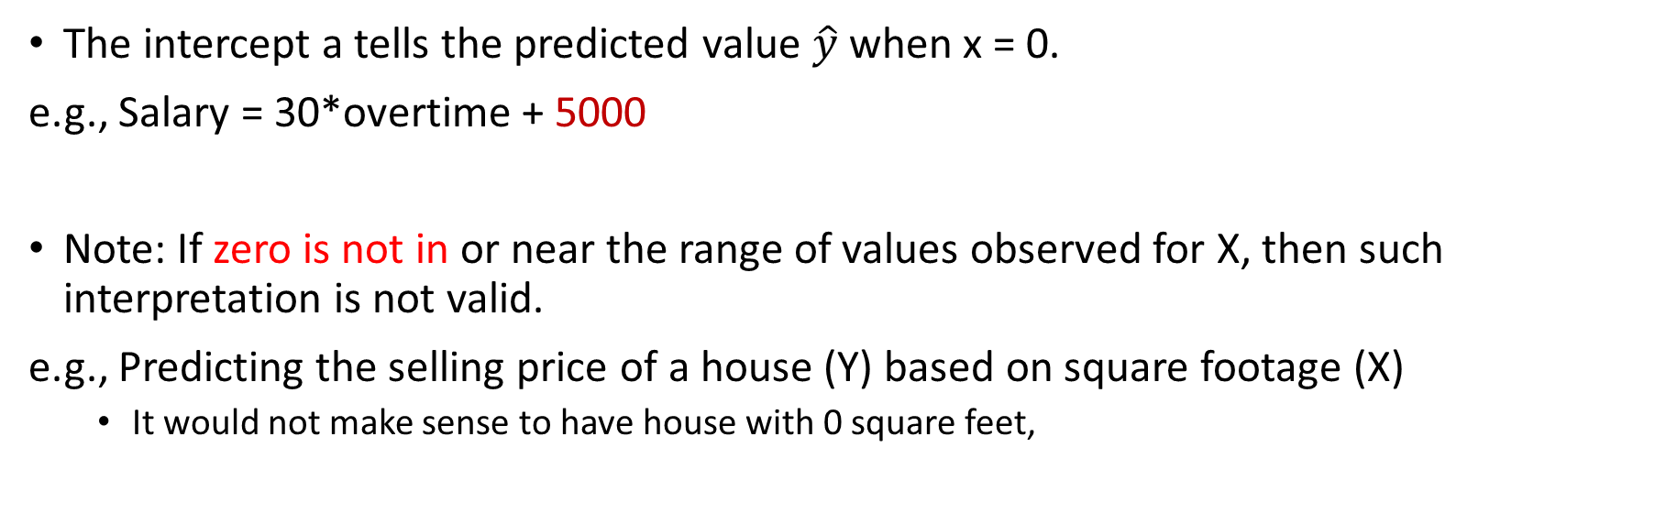
Interpreting the Intercept
$$\hat{y}=bx+a$$
The intercept a tells the predicted value $\hat{y}$ when x = 0.
e.g., Salary = 30*overtime + 5000
Note: If zero is not in or near the range of values observed for X, then such interpretation is not valid.
e.g., Predicting the selling price of a house (Y) based on square footage (X)
It would not make sense to have house with 0 square feet,
$$\hat{y}=bx+a$$
PRICE = 83*SQRFT + 12,510
Notes:
16

Slide 17
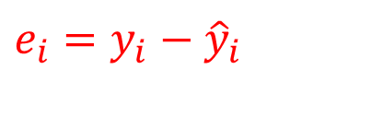
Residual
A residual (prediction error) is the difference between the observed value (𝒚) and the predicted value (𝒚 ̂) for each observation.
$$e_{i}=y_{i}−{\hat{y}}_{i}$$

Slide 18
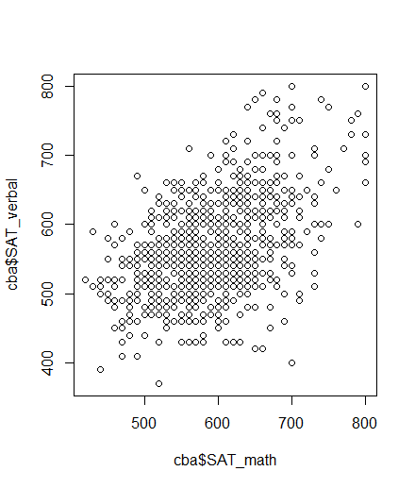
Problem Statement : Which Line is the Best Fit
There are many possible “fits”, which of these lines is the best?
A small residual means that the response variable is close to what it was predicted to be under the fitted regression model.
The target is to find a line fits to training data best, so we need to find the least total residuals.

Slide 19
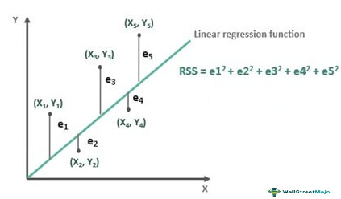
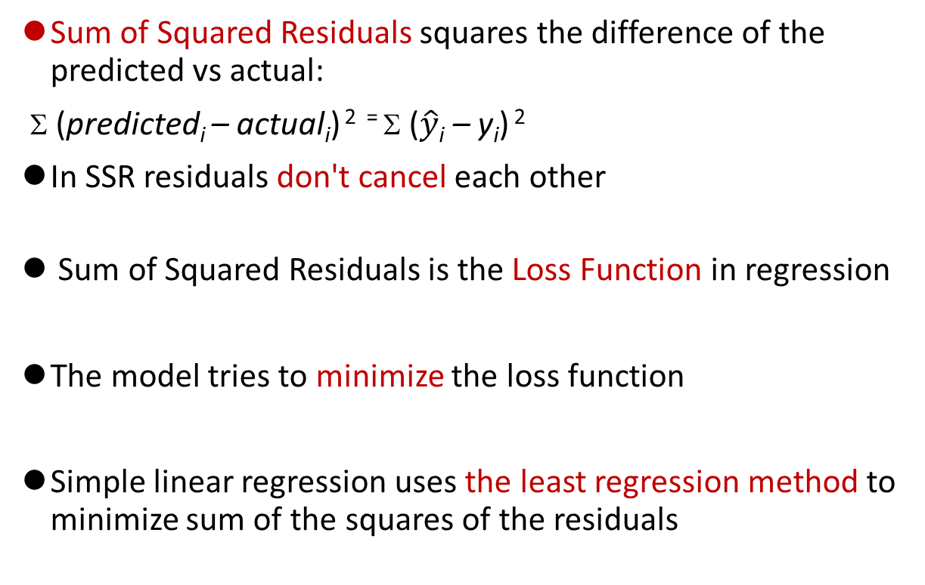
Loss Function
Sum of Squared Residuals squares the difference of the predicted vs actual:
Σ (predicted_{i} – actual_{i}) ² ⁼ Σ ($\hat{y}$_{i} – y_{i}) ²
In SSR residuals don't cancel each other
Sum of Squared Residuals is the Loss Function in regression
The model tries to minimize the loss function
Simple linear regression uses the least regression method to minimize sum of the squares of the residuals
Notes:
Would choose middle 9+9 < 49

Slide 20
Bias vs Error
Bias is a systematic error that occurs due to inability of the model to fit training data. High bias indicates underfitting.
In a model with a low bias, average of error is near zero
In a model with a high bias, average of error is not zero and model is biased to higher or lower values

Slide 21
Approaches to Minimize SSR
The closed form for finding linear regression which is computationally expensive for large datasets.
There are also iterative techniques to estimate optimal weights with less computation cost.
One common iterative approach is gradient descendent.

Slide 22
Closed-form Method
ŷ = a + bx
SSR = Σ(y — ŷ)² = Σ(y — a — bx)²
To minimize SSR, we take the partial derivatives of SSR with respect to m and b, set them equal to zero, and solve for a and b.

Slide 23
Partial Derivative
SSR = Σ(y — a — bx)²
Taking the partial derivative of SSR with respect to b:
∂SSR/∂b = -2Σx(y — a — bx) = 0
Σxy — aΣx — bΣx² = 0
b = (Σxy — aΣx) / Σx²
Taking the partial derivative of SSR with respect to a:
∂SSR/∂a = -2Σ(y — a — bx) = 0
Σy — na — bΣx = 0
a = (Σy — bΣx) / n = 𝑦 ̄−𝑏𝑥 ̄

Slide 24
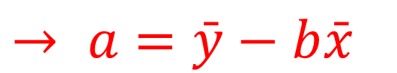
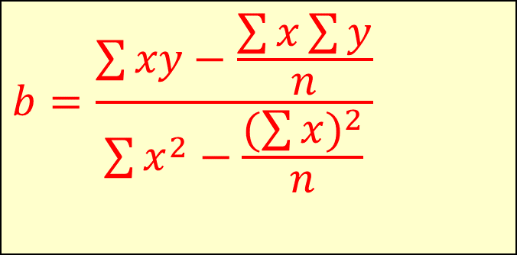
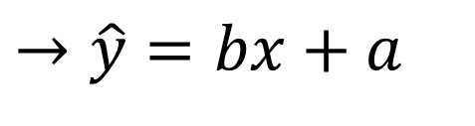
The Least Squares Equation
1) b = (Σxy — aΣx) / Σx²
2) a = (Σy — bΣx) / n
$$b=\frac{\sum{xy−\frac{\sum{x\sum{y}}}{n}}}{\sum{x^{2}−\frac{(\sum{x})^{2}}{n}}}$$
1,2 →
$$→ a=\bar{y}−b\bar{x}$$
$$→\hat{y}=bx+a$$

Slide 25
Regression Line Calculation - Example
Chemical reaction time based on Mass

Slide 26
Regression Line Calculation - Example
 | Time | Mass
 | 5 | 40
 | 7 | 120
 | 12 | 180
 | 16 | 210
 | 20 | 240
Mean | 12 | 158

Slide 27
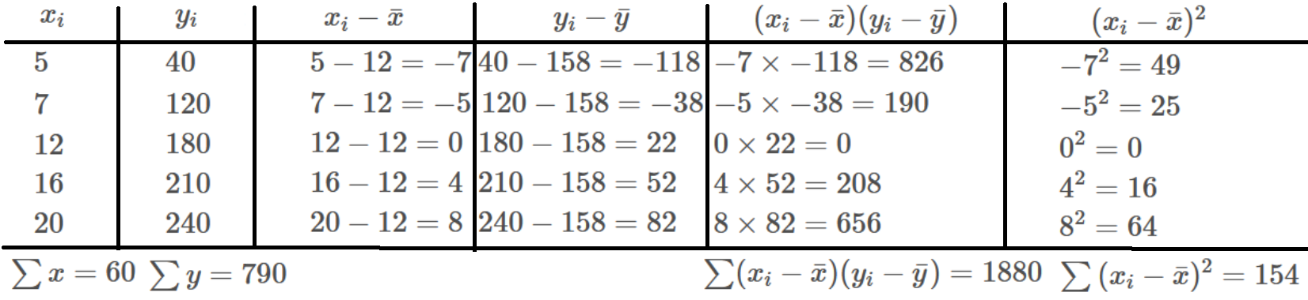
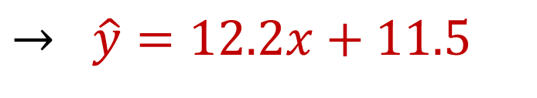
Regression Line Calculation - Example
$$→ \hat{y}=12.2x+11.5$$

Slide 28
Gradient Descent Approach
Gradient descent is a greedy optimization algorithm used to minimize the loss function of the model (SSR).
The derivative is called a gradient, which is the vector of partial derivatives with respect to each dimension of the input.
Iteratively subtract the gradient with respect to the model parameters (slope and intercept)
moves in the direction of the steepest ascent towards smaller loss

Slide 29
Gradient Descent - Intuitive
Zero slope of gradient → it is Minimum point (sometimes local minimum)
Big slope of gradient It→ is far from zero slope (which we are looking for) → we need bigger decrease
Small slope of gradient → It is near to zero slope → we need smaller decrease (not passing by)
1,2,3 → A greedy approach:
In each step, subtract a value proportional to last gradient (bigger value for big gradient and smaller value for small gradient) to get closer to minimum point :

Slide 30
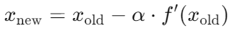
Learning Process
It starts with random initial numbers for parameters and iteratively updating the model’s parameters in the negative gradient direction.
In each iteration of the algorithm, the gradient of the cost function with respect to each parameter is computed.
The size of the step is controlled by the learning rate, which determines how quickly the algorithm moves towards the minimum.
The process is repeated until the cost function converges to a minimum, indicating that the model has reached the optimal set of parameters.

Slide 31

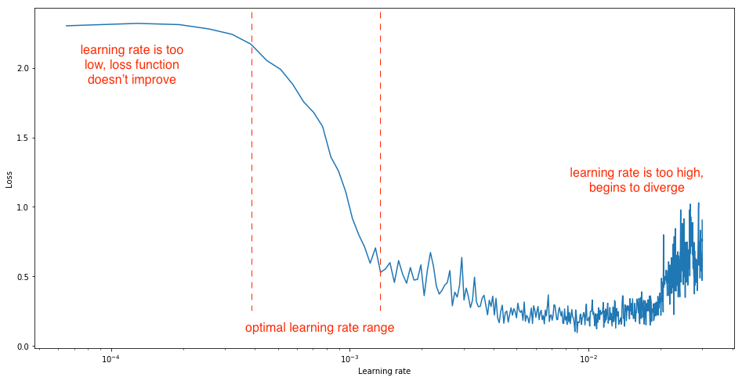
Learning Rate
Learning rate is a hyperparameter that determines how big a step is taken.
A too high learning rate will make the learning jump over minima
A too low learning rate will either take too long to converge or get stuck in a local minimum
Usually, optimal learning rate should be somewhere between 0.001 and 0.01 depends on optimization method

Slide 32
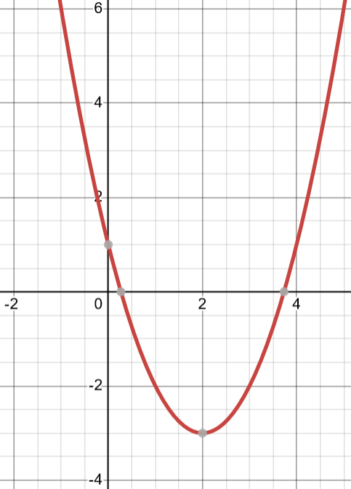
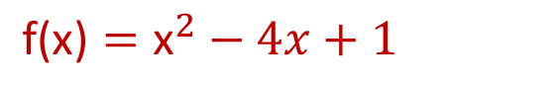
Gradient Descent – Example1
$$\text{f}\text{(}\text{x}\text{)}={\text{x}}^{2}−4x+1$$
Suppose that we want to find the x that minimize f(x):
(Minimum of the f(x) is -3 at x=2)
1- Calculate the derivative
The derivative (or gradient) of the function is: f′(x)=2x−4
2- Choose a starting point
Start at x0=9. (This is an initial guess for the minimum)
3- Choose a learning rate
learning rate α=0.1

Slide 33
Gradient Descent – Example1
4- Perform the gradient descent step
To update value of x, the formula is used:
Iteration 1:
Starting point: x0=9
f′(x)=2x−4 → Gradient at x0: f′(9)=2×9−4=14
Update x: x1= x0 – a*f′(x0) = 9 − 0.1×(14)=7.6

Slide 34
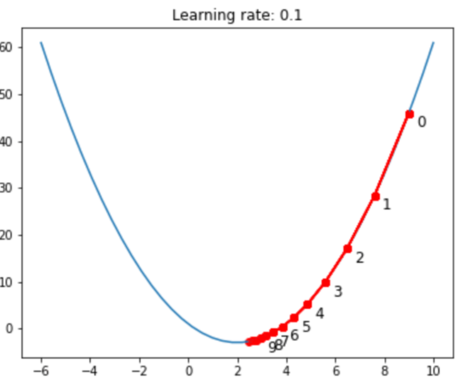
Gradient Descent – Example1
Iteration 2:
x1=7.6
f′(x)=2x−4 → f′(x1)=2(7.6)−4=15.2−4=11.2
Update x: x2= x1 – α*f′(x0) =7.6−0.1×11.2=7.6−1.12=6.48
Iteration 3:
x2=6.48
f′(x)=2x−4 → f′(x2)=2(6.48)−4=12.96−4=8.96
Update x: x3 = x2 – α*f′(x0) =6.48−0.1×8.96=6.48−0.896=5.584
Iteration 4:
x3=5.584
f′(x)=2x−4 → f′(x3)=2(5.584)−4=11.168−4=7.168
Update x: x4 = x3 – α*f′(x0) =5.584−0.1×7.168=5.584−0.7168=4.8672
Iteration 5:
x4=4.8672
f′(x)=2x−4 → f′(x4)=2(4.8672)−4=9.7344−4=5.7344
Update x: x5 = x4 – α*f′(x0) =4.8672−0.1×5.7344=4.8672−0.57344=4.29376

Slide 35
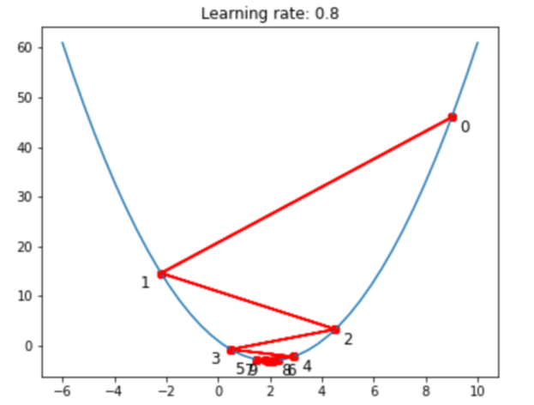
Gradient Descent – Example2
by taking a learning rate of 0.8 and starting point at x=9
Iteration 1:
Starting point: x0=9
f′(x)=2x−4 → Gradient at x0: f′(9)=2×9−4=14
Update: x1= x0 – a*f′(x0) = 9 − 0.8×(14)=-2.2
Iteration 2:
x1= -2.2
f′(x)=2x−4 → Gradient at x1: f′(-2.2)=2×-2.2−4= -8.4
Update: x2= x1 – a*f′(x1) = -2.2 − 0.8×(-8.4)= 4.52

Slide 36
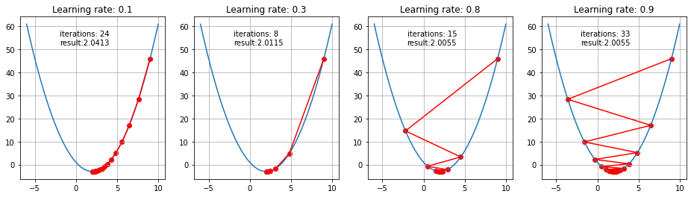
Effect of Learning Rate
First 10 steps taken by GD for small and big learning rates

Slide 37
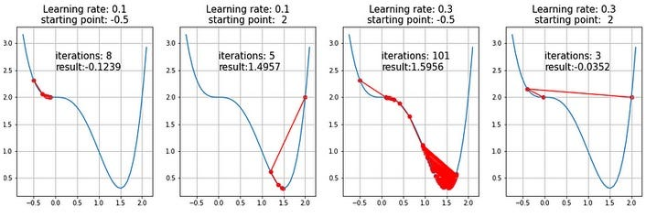
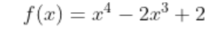
Saddle points
Existence of a saddle point imposes a challenge for the gradient descent algorithms and obtaining a global minimum is not guaranteed
Investigation of saddle points and how to escape from local optimum is a subject of ongoing studies and various solutions were proposed
A semi-convex function

Slide 38
Multiple Linear Regression
Explains a dependent variable using more than one independent variable
It evaluates the relative effect of independent variables on the dependent variable when holding all the other variables in the model constant.

Slide 39
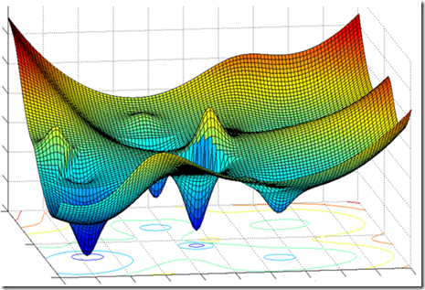
Gradient Descent in High Dimensional Data
In high-dimensional spaces (many features), gradient descent can struggle due to the "curse of dimensionality." The optimization landscape becomes more complex, making it harder for the algorithm to find the minimum efficiently.

Slide 40
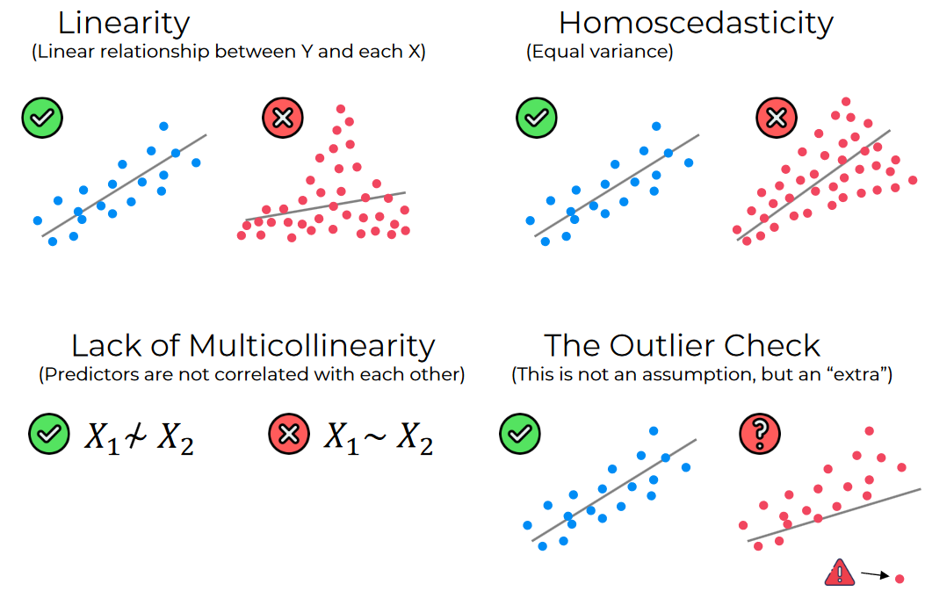
Conditions for regression
Some Assumptions of Linear Regression
The chosen sample is representative of the population.
Linear association between dependent and independent variables
Independent variables are not highly correlated linearly (multicollinearity)
Constant variability (homoscedasticity) of residuals

Slide 41
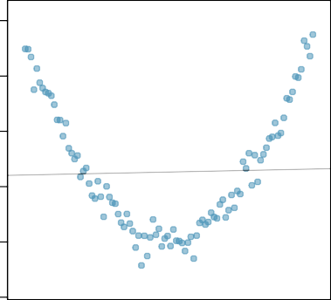
Conditions for regression
Linearity
Linear association between dependent and independent variables
Linear associations can be recognized using r
Type of association can be recognized using scatter plots
Scatter Plot
1000 1500 2000
y
500
Non-linear association →
0
x

Slide 42
Multicollinearity
In multicollinearity two or more independent variables are highly correlated with each other
Unstable Coefficient Estimates: The estimated coefficients may become highly sensitive to changes in the model or data.
Difficulty in Interpretation: When predictors are highly correlated, it becomes challenging to interpret the effect of each predictor on the dependent variable since their effects are intertwined.
Tis a high correlation between x₁ and x₂, then it is difficult to determine b₁ and b₂. If both are e.g. completely equal, the regression model does not know how large b₁ and b₂ should be, becoming unstable.

Slide 43
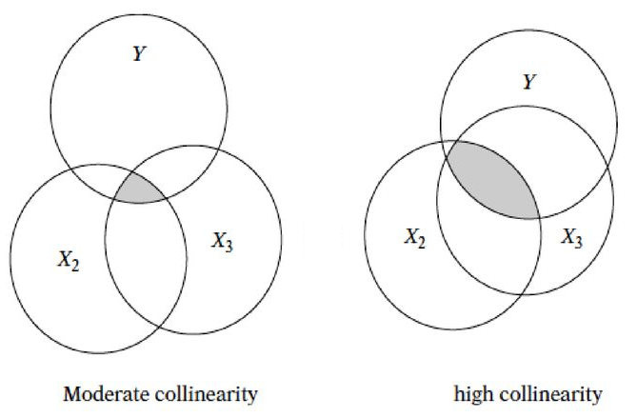
Addressing Multicollinearity
Compute the correlation matrix of independent variables to detect high correlations (e.g., above 0.7)
Remove or Combine Highly Correlated Predictors:
Remove one of each pair of highly correlated variables
Use feature reduction techniques like PCA to transforms the variables into a set of uncorrelated variables
3. Sometimes increasing the size of training data can help to decrease the impact of multicollinearity.

Slide 44
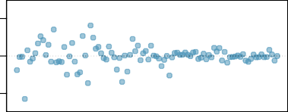
Heteroscedasticity
Variance of the residuals is not constant across all levels of the independent variables because:
Important predictor variables are left out of the model
The relationship between the independent and dependent variables may not be linear
Outliers or extreme values in can dependent variable disproportionately influence the variance of residuals
The variability of the dependent variable increases with its mean. For example, in financial data, high-value investments might have more variability in returns compared to low-value investments, leading to heteroscedastic residuals.
Etc.
−2000 0 2000
Residuals
Residuals range changes as x gets large
x

Slide 45
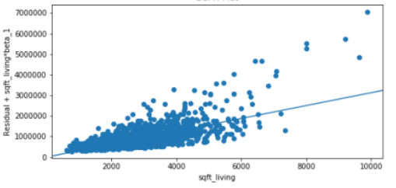
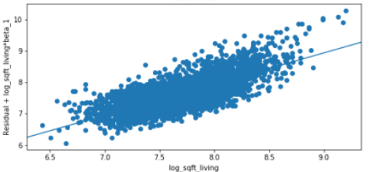
Addressing Heteroscedasticity
Using data preprocessing to remove outliers and noises
Adding omitted variables or modify variables
Using non-linear model if the relationships between dependent and independent variables is not linear
Apply transformations that stabilize variance of dependent variables
E.g., log transformation

Slide 46
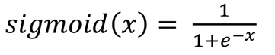
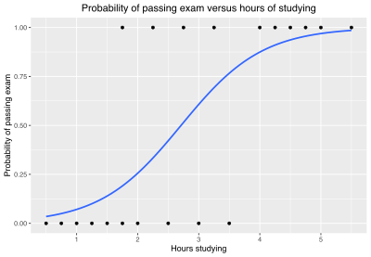
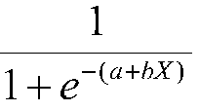
Logistic Regression
Uses Sigmoid function
Produces a number between 0 and 1
Can be used for binary classification as it produces a value between 0 and 1
Predicts the probability P(Y=1∣x) and classifies the input based on a threshold.
Single-Variate Logistic Regression
y = Sigmoid (bX + a) =

Slide 47
Logistic Regression - Example
Predict spam (label) emails using the following features:
Feature 1: Number of times the word "free" appears in the email
Feature 2: Number of times the word "win" appears in the email
Suppose after training, the model gives us the following equation:
Spam = Sigmoid (0.5×Free Count+0.8×Win Count−1.0)
Free Count | Win Count | Spam (Label)
3 | 1 | 1
0 | 0 | 0
1 | 2 | 1
0 | 1 | 0
2 | 3 | 1

Slide 48
Logistic Regression - Example
Probability(Spam ∣ Free Count, Win Count)= Sigmoid (0.5×Free Count+0.8×Win Count−1.0)
To classify new emails, we can use the trained model:
Probability(Spam∣2,1)= Sigmoid(0.5×2+0.8×1−1.0) = Sigmoid (1.6) ​≈0.832
Since 0.832 is greater than 0.5, the model classifies the email as spam.
Probability(Spam∣1,0)= Sigmoid(0.5×1+0.8×0−1.0) = Sigmoid (-0.5) ​≈0.377
Since 0.377 is less than 0.5, the model classifies the email as not spam.
Free Count | Win Count | Spam (Label)
2 | 1 | ?
1 | 0 | ?

Slide 49
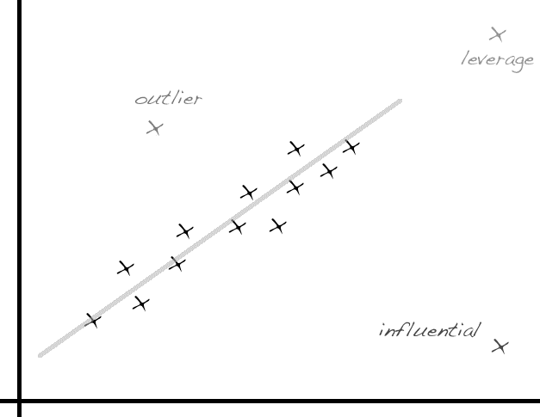
Data Pre-processing for Regression
Categorical variables need to be recoded into a series of variables which can then be entered into the regression model (e.g., one-hot encoding).
Missing Values are required to be imputed
Normalizing data is recommended since features with larger ranges may dominate the gradient descent process, causing features with smaller ranges to contribute less to the model if they are not scaled appropriately
Filter out outliers is recommended for regression which is prone to outliers

Slide 50
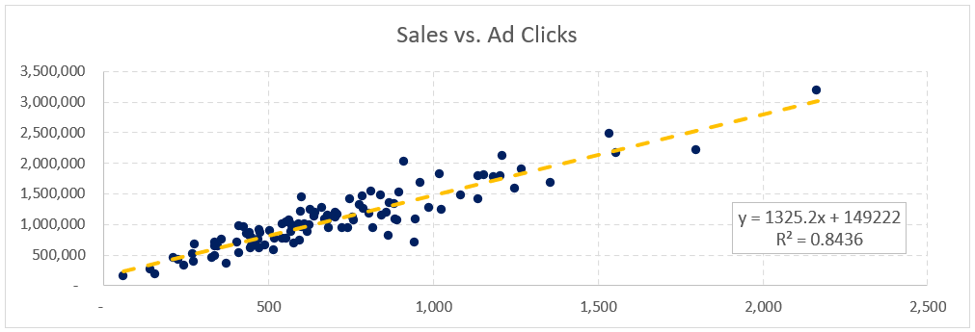
Applications of Regression
Very common in financial predictions:
Sales forecasting
Real estate prices
Economic Indicators

Slide 51
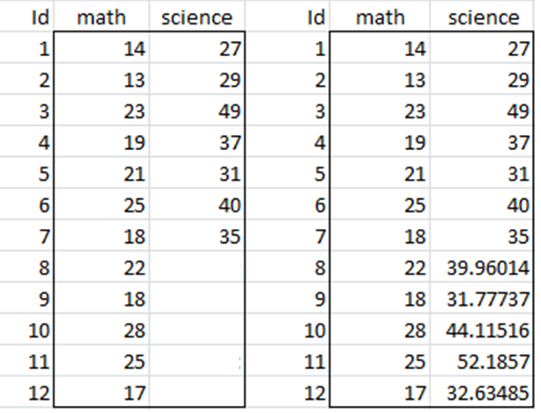
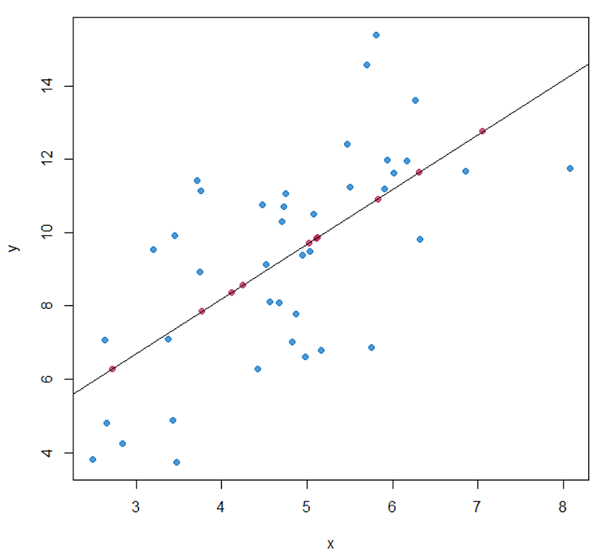
Applications of Regression
Synthetic data / Imputation

Slide 52

K Nearest Neighbor (KNN)
KNN is a supervised learning technique (Classifier).
Classify a new data point like similar existing training example(s).
Similar means similar feature values (nearest feature values)
← Plus(+) or Minus(-) Class?
Idea: Similar features indicates similar class
52

Slide 53

Example of Nearest Neighbors
K-nearest neighbors of a record x are data points that have the k smallest distance to x
Class of x is assigned based on majority of k K-nearest neighbors
Distance is the Loss Function in KNN
We need a measure for distance

Slide 54
Distance Measures
Euclidean Distance:
Manhattan Distance:
Chebyshev Distance:
$$d(x,y)=\sqrt{(x−y)^{2}}=\sqrt{\sum_{i=1}^{d}{(x_{i}−y_{i})^{2}}}$$
$$d(x,y)=|x−y| =\sum_{i=1}^{d}{|x_{i}−y_{i}|}$$
$$d(x,y)=max_{1≤i≤d}|x_{i}−y_{i}|$$
1 2 3 4 5
Feature 2
X (1,5)
$$Euclidean=\sqrt{\sum_{i=1}^{d}{(x_{i}−y_{i})^{2}}}= ({(1−3)}^{2}+{(5−1)}^{2})^{\frac{1}{2}}=4.47$$
$$Manhattan=\sum_{i=1}^{d}{|x_{i}−y_{i}|}=|\left(1−3\right)|+|(5−1)|=6$$
$$Chebyshev=Max(\left|\left(1−3\right)\right|,|(5−1)|)=4$$
$$4$$
Y (3,1)
$$2$$
Feature 1
1 2 3 4

Slide 55

KNN Algorithm
Get a test data point
Calculate distance between data points with training data points
Find k (hyper-parameter) nearest neighbors (less distance)
Assign a label based on labels of nearest neighbors (Majority Voting / Regression)
Repeat for other unlabeled data

Slide 56
KNN Example
Features: height(cm) and weight (kg)
Labels: Normal / Underweight
Weight | Height | Class (Label)
51 | 167 | Underweight
62 | 182 | Normal
69 | 176 | Normal
64 | 173 | Normal
65 | 172 | Normal
56 | 174 | Underweight
58 | 169 | Normal
57 | 173 | Underweight
55 | 170 | Normal
Datapoint with Unknown Class
57 kg | 170 cm | ?

Slide 57
KNN Example
Euclidean Distance = $\sqrt{(Weight1−Weight2)^{2}+(Hight1−Hight2)^{2}}$
Weight | Height | Class | Euclidean Distance
51 | 167 | Underweight | 6.7
62 | 182 | Normal | 13
69 | 176 | Normal | 13.4
64 | 173 | Normal | 7.6
65 | 172 | Normal | 8.2
56 | 174 | Underweight | 4.1
58 | 169 | Normal | 1.4
57 | 173 | Underweight | 3
55 | 170 | Normal | 2
$$\sqrt{(51−57)^{2}+(167−170)^{2}}$$
$$\sqrt{(62−57)^{2}+(182−170)^{2}}$$
$$…$$
57 kg | 170 cm | ?
Unknown data point

Slide 58
3-NN Example – Least Distance (Loss)
Weight | Height | Class | Euclidean Distance
51 | 167 | Underweight | 6.7
62 | 182 | Normal | 13
69 | 176 | Normal | 13.4
64 | 173 | Normal | 7.6
65 | 172 | Normal | 8.2
56 | 174 | Underweight | 4.1
58 | 169 | Normal | 1.4
57 | 173 | Underweight | 3
55 | 170 | Normal | 2
K=3
Normal
57 kg | 170 cm

Slide 59
Number of Neighbors (K)
If k is too small, sensitive to noise points.
If k is too large, neighborhood may include points from other classes (Not enough fine-grained)
Choose an odd “K” value for a Binary Classification problem.
“K” must not be a multiple of the number of classes for a Multi-class Classification problem
Rule of thumb:
K <= sqrt(N)
N: number of training points

Slide 60
Optimal K
We can use Elbow method to find optimal K
Choosing a K performs best on validation data

Slide 61

KNN Advantages
Simple and interpretable
Provides reasonable results on small datasets with limited features
KNN is a lazy learner, it requires no training time
Requires little tuning of hyper-parameters.
Learn non-linear decision boundaries when used for classification.

Slide 62

KNN Disadvantages
Computationally Expensive for Large Datasets: To determine the nearest neighbour of a data point, must compute the distance to all training data.
Pre-sort training data points into fast data structures
Cluster data points and just use centroids as training set
Compute only an approximate distance
Condensing
Curse of Dimensionality : Required amount of training data increases exponentially with dimension. Prediction accuracy can quickly degrade when number of attributes grows
Remove irrelevant attributes
More training data

Slide 63
Data Pre-processing for KNN
Missing Values are required to be imputed since distance metrics are employed.
Normalizing data is recommended since distance-based classifiers are sensitive to scaling and different features may have different measurement scales
Filter out outliers is recommended for KNN algorithm since KNNs with smaller number of K are prone to noise and outliers

Slide 64

Applications of KNN
Many applications including imputing missing values
Daily Dose of Data Science

Slide 65

Assignment 4
Train a multiple linear regression on hw4_train.csv dataset with ‘BloodPressure’ as outcome (dependent variable) and all other attributes as features (Independent variables).
Using the regression model, predict and set values of ‘BloodPressure’ in hw4_test.csv dataset.
Train 19 KNN models with k from 1 to 19 on hw4_train.csv dataset with ‘Outcome’ as label and all other attributes as features.
Calculate accuracy of the model for test data (containing predicted values of ‘BloodPressure’).
Report the best K for this KNN model.

